Slide 1
ABSTRACT
Text classification has become one of the most useful applications this process includes techniques like Tokenizing, Stemming, and multi classification. This project uses NLP technique and SVM algorithm, that are used to classify online comments based on their level of toxicity.

Slide 2
INTRODUCTION
Social media is a place where a lot of discussions happen, being anonymous while doing so has given the freedom to many people to express their opinions freely.
But people who disagree with a point of view extremely can misuse this freedom sometimes. Sharing things that you care about will become a difficult task with this constant threat of harassment or toxic comments online.
This will eventually lead to people not sharing their ideas online and stop asking for other people’s opinion on them.
Unfortunately, the social media platforms face these issues all the time and find it difficult to identify and stop these toxic remarks before it leads to the abrupt end of conversations.

Slide 3
In this project using Natural Language Processing with regression technique to solve this problem of identifying the toxicity of online comments. Word embeddings will be used in conjunction with recurrent with Support Vector Machine (SVM).

Slide 4
PROPOSED SYSTEM
In this project a Support vector machine model to classify the comments and calculate the model’s accuracy. The comments are first passed to a tokenizer or vectorizer to create a dictionary of words, then an embedding matrix is created after which it is passed to a model to classify.

Slide 5
SYSTEM REQUIREMENTS
HARDWARE REQUIREMENTS:
System : i3 Core.
Hard Disk : 120 GB.
Input Devices : Keyboard, Mouse
Ram : 4 GB
SOFTWARE REQUIREMENTS:
Operating system : Windows
Coding Language : Python
Tool : Jupyter Notebook

Slide 6


ARCHITUCTURE
insult comments
toxic comments
Multi-Label Classification
SVM regression
Cleaning Data
Severe toxic comments
Removing Stop Words
obscene comments
TF-IDF
NLP
threat comments
Identity hate comments

Slide 7

ARCHITUCTURE
Classified Toxic comment data
Random Forest Algorithm
Flask web API user interface
Input Text/comment
Predict comment is Toxic or Not and How much toxic contains in that comment

Slide 8
NLP
NLP is a part of computer science and ai which deals with human languages.
Application of NLP: Sentimental Analysis, Chatbot, Speech Recognition, Machine Translation, Spell Checking, Information Extraction, Keyword Search, Advertisement Matching.
NLP Components: Natural Language Understanding and Natural Language Generation.
NLU - Mapping input to useful representation, Analyzing different aspects the language. Ambiguity- Lexical, Syntactic, Referential
NLG - Text Planning, Sentence Planning, Text Realization

Slide 9
STEPS OF NLP
Tokenization - divide the word by word in a sentence.
Stemming - normalize words into its base form or root form
eg. affection, affects, affections, affected, affection, affecting
Lemmatization - Groups together different inflected forms of a word called lemma. somehow similar to stemming, as it maps several words into one common root. output of lemmatization is proper word
eg. a lemmatiser should map gone, going and went into go.
POS Tags - General speaking Grammatical type of the word are POS tags, like noun, verb, adjective, adverb article and many more.
NER(Name entity Recognition) - recognizes the movie name, monetary value, organization name, location, quantities name, person name.
3 steps to NER 1. Noun Identification, 2. Phrase Classification, 3. Entity Disambiguation.

Slide 10

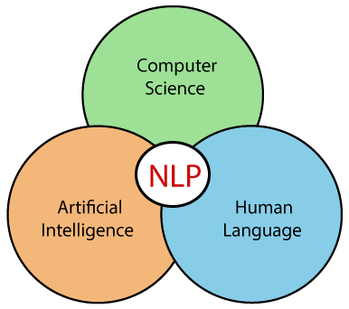
Chunking - picking up individual pieces of information and grouping them into bigger pieces.
NLTK – Natural Language Tool Kit(NLTK) is a library which is heavily used for all the natural language processing and the text analysis.

Slide 11
Algorithms explanation
RANDOM FOREST ALOGRITHM
Random forest is a supervised learning algorithm which is used for both classification as well as regression. But however, it is mainly used for classification problems.
As we know that a forest is made up of trees and more trees means more robust forest. Similarly, random forest algorithm creates decision trees on data samples and then gets the prediction from each of them and finally selects the best solution by means of voting.
It is an ensemble method which is better than a single decision tree because it reduces the over-fitting by averaging the result. Random forest is nothing but a collection of multiple decision tree models.
Random forests creates decision trees on randomly selected data samples, gets prediction from each tree and selects the best solution by means of voting. It also provides a pretty good indicator of the feature importance.
It works in four steps:
Select random samples from a given dataset.
Construct a decision tree for each sample and get a prediction result from each decision tree.
Perform a vote for each predicted result.
Select the prediction result with the most votes as the final prediction.

Slide 12
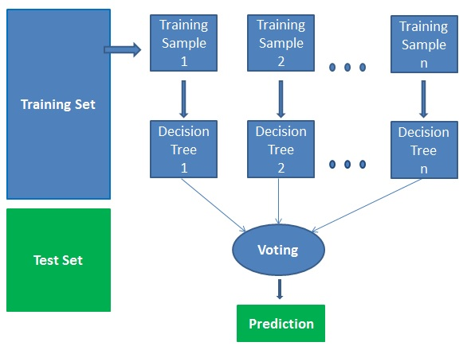

Slide 13
Advantages:
Random forests are considered as a highly accurate and robust method because of the number of decision trees participating in the process.
It does not suffer from the over fitting problem. The main reason is that it takes the average of all the predictions, which cancels out the biases.
The algorithm can be used in both classification and regression problems.
Random forests can also handle missing values. There are two ways to handle these: using median values to replace continuous variables, and computing the proximity-weighted average of missing values.
You can get the relative feature importance, which helps in selecting the most contributing features for the classifier.

Slide 14
Dataset Description
Dataset Description
You are provided with a large number of Wikipedia comments which have been labeled by human raters for toxic behavior. The types of toxicity are:
toxic
severe_toxic
obscene
threat
insult
identity_hate

Slide 15
File descriptions
train.csv - the training set, contains comments with their binary labels
test.csv - the test set, you must predict the toxicity probabilities for these comments. To deter hand labeling, the test set contains some comments which are not included in scoring.
sample_submission.csv - a sample submission file in the correct format
test_labels.csv - labels for the test data; value of -1 indicates it was not used for scoring; (Note: file added after competition close!)

Slide 16
Functional Requirements
NLP is used For Comment words separation, in these comments npl uses these techniques tokenization, stemming and vectorization.
This model is used to Classify the all toxic comments category for a given dataset.
When the system has any input value being missed, it could not provide accurate results.
From the input dataset, there are 8 attributes that defines in that 6 are the categories of the comments and reaming are the comment and Id, of which having of 159571 tuples, that define the classification of the toxic comments are considered.

Slide 17
Non Functional Requirements
Scalability: The model is designed to pre-process the data and deliver correct results varying with the scalable data
Accuracy: The model uses SVM machine learning algorithm for providing accurate results based on input data
Serviceability: This project is used know the type of comment and this service is we can provide to all social media platform.
Reliability: Accuracy Scores that are highly reliable are precise, reproducible, and consistent from testing set.

Slide 18
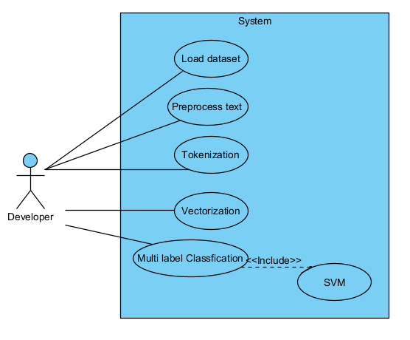
UML - USECASE

Slide 19
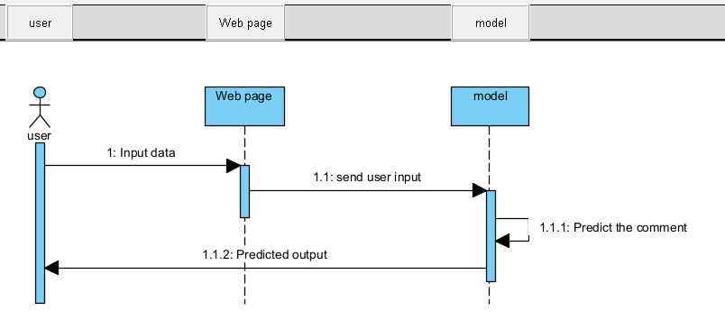
UML - Sequence

Slide 20
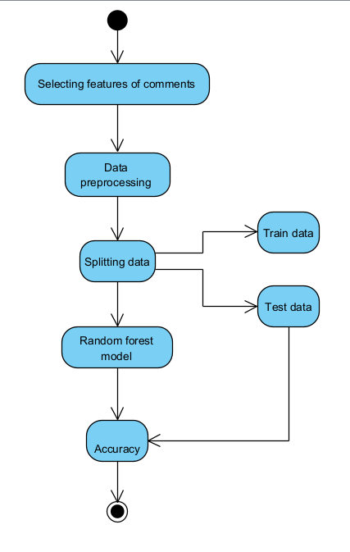
UML - Activity

Slide 21
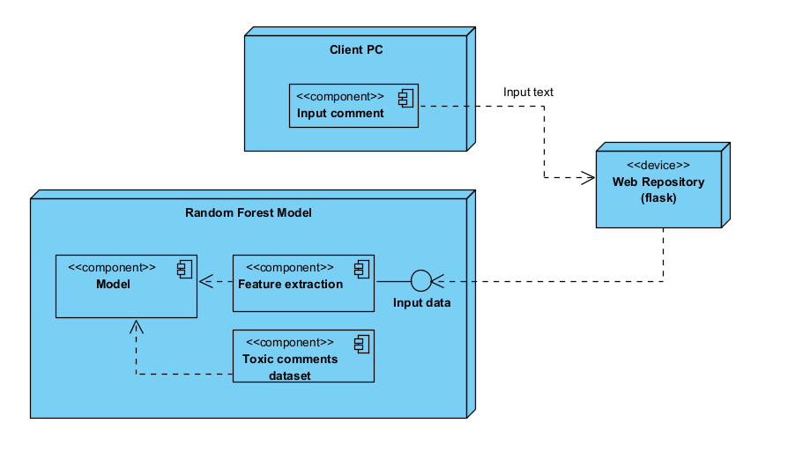
UML - Deployment

Slide 22
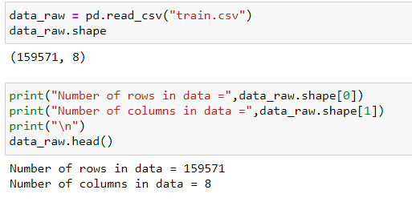
IMPLEMENTATION
Download Dataset
Importing Dataset

Slide 23
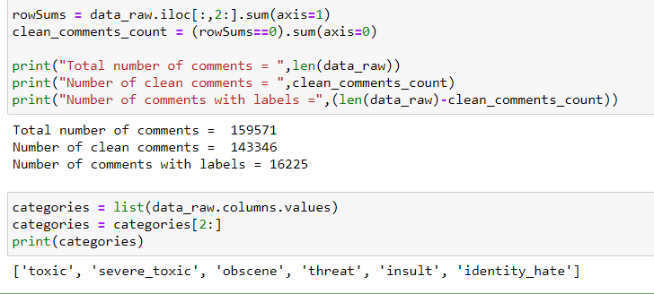
Calculating number of comments under each label

Slide 24
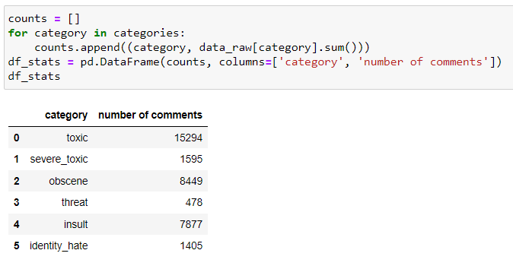

Slide 25
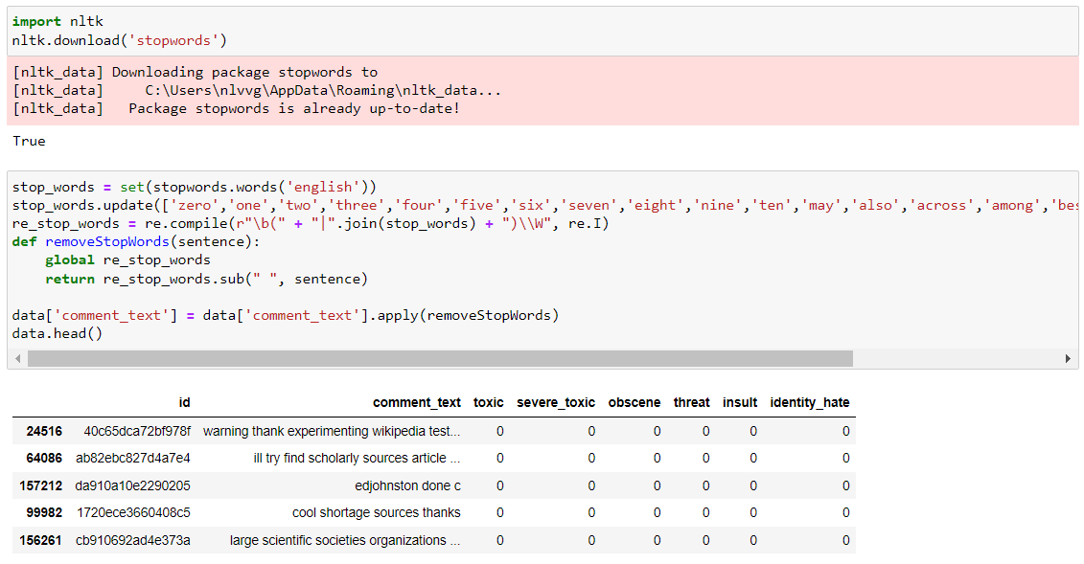
Removing Stop Words

Slide 26
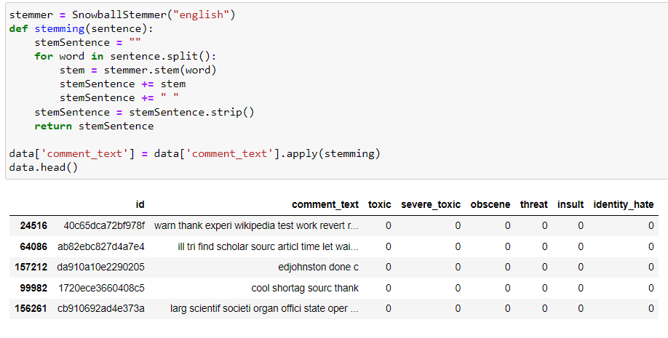
Stemming

Slide 27
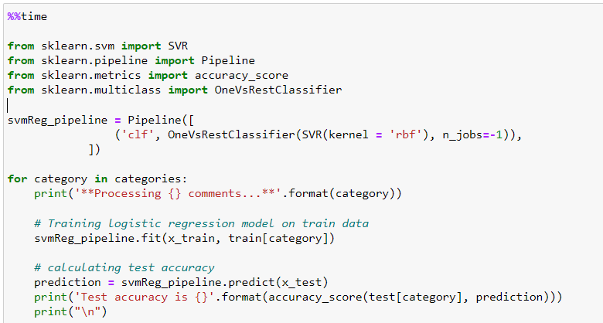
Multi-Label Classification using SVM

Slide 28
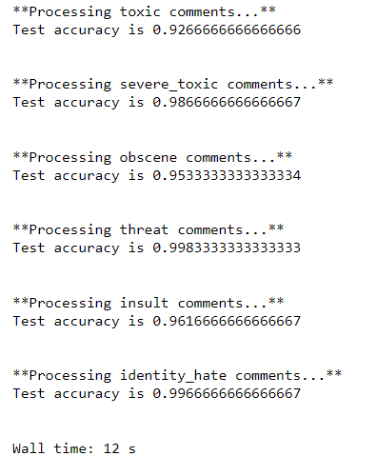
Processing outputs for every category comments with accuracy

Slide 29
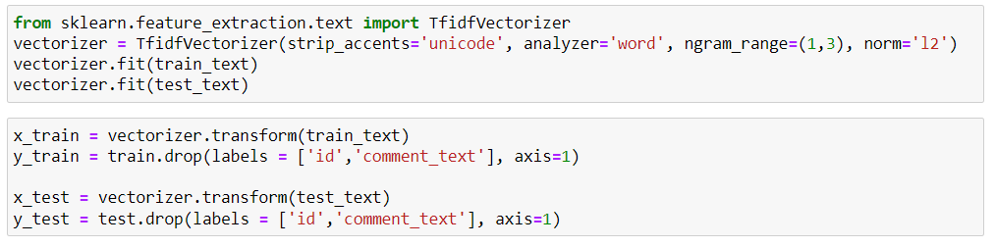
TF-IDF

Slide 30
Random forest algorithm output

Slide 31
Web user Interface

Slide 32
CONCLUSION
It is important to make sure that people with different ideas are heard without the fear of any toxic and hateful remarks. And after analyzing using npl and SVM approaches to solve this problem of classification of toxic comments online, it is found that the accuracy of toxic comments 92.66%, severe toxic comments 98.66%, obscene comments 95.33%, Threat comments 99.83%, insult comments 96.16% and Threat comments 99.83%, insult comments 99.66%.

Slide 33
Future scope
Future scope for this analysis would be integrating such classification algorithms into social media platforms to automatically classify and censor or toxic comments.

Slide 34
REFERENCE
[1] “Toxic Comment Classification using Natural Language Processing”, A. Akshith Sagar, J. Sai Kiran, 2020, IRJET

